Slide 1



Employee Attrition Analysis
By: Group 6

Slide 2

Introduction
Retaining employees is a critical challenge for organizations, with disengagement costing billions annually.
Our project leverages HR analytics to uncover patterns in attrition, satisfaction, and performance. By identifying key drivers such as career growth, recognition, and management practices, we aim to provide actionable insights for improving employee engagement and retention strategies. This analysis empowers HR leaders to build a more satisfied and resilient workforce.

Slide 3
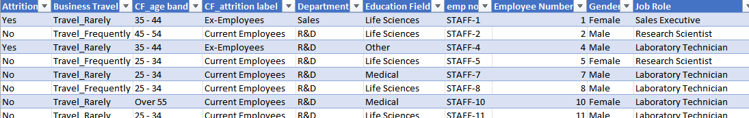
Data Overview
1
2
Size: 39 x 1470
Demographics: Age, Gender, Education Field
Employment: Job Role, Department, Business Travel
Performance & Satisfaction: Job Satisfaction, Performance Rating
Attrition Details: Attrition Status, Tenure

Slide 4

Design Process
Key Factors
Designed for actionable insights and HR decision-making.
Focused on creating interactive, user-friendly dashboards.
Challenges
Striking a balance between detailed analysis and simplicity.
Inspiration
Insights from Gallup and Work Institute reports on attrition and satisfaction.
Key Insights
Education, tenure, satisfaction, and travel impact attrition.
Early attrition, frequent travel dissatisfaction, and department-specific challenges highlight areas for targeted interventions.

Slide 5
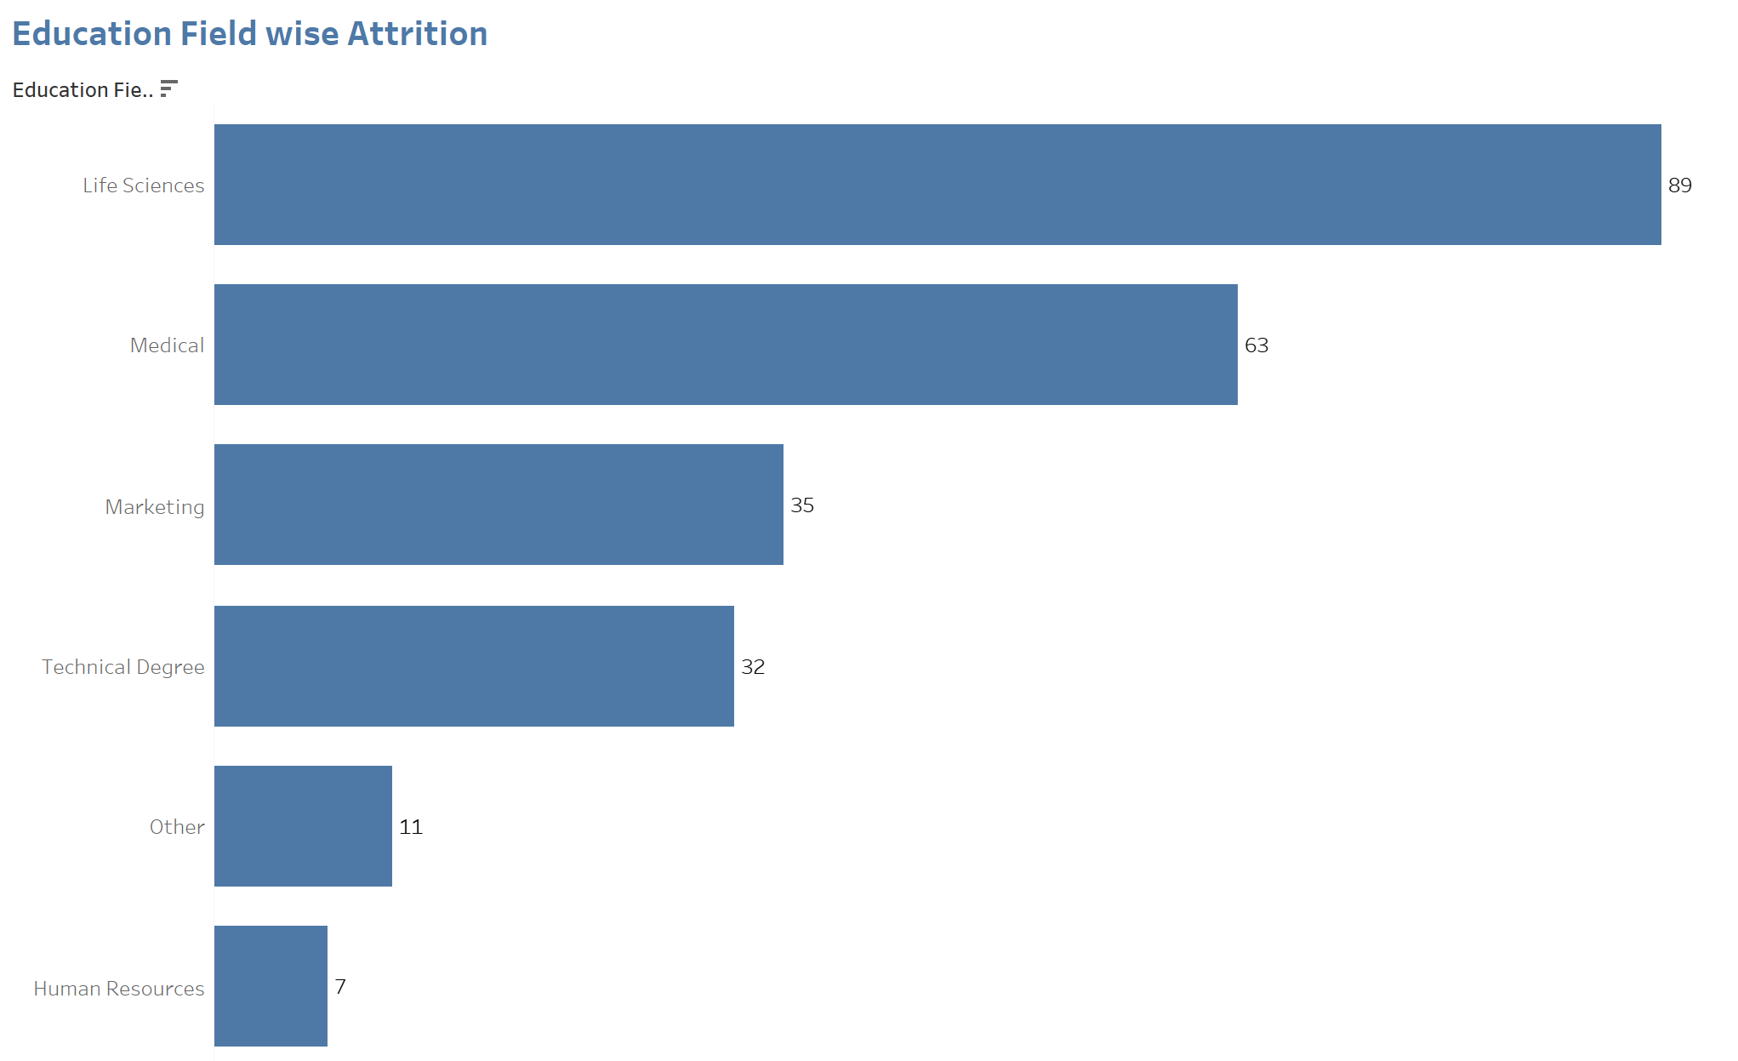

Visualizations
It helps in targeting specific employee groups for retention efforts.

Slide 6
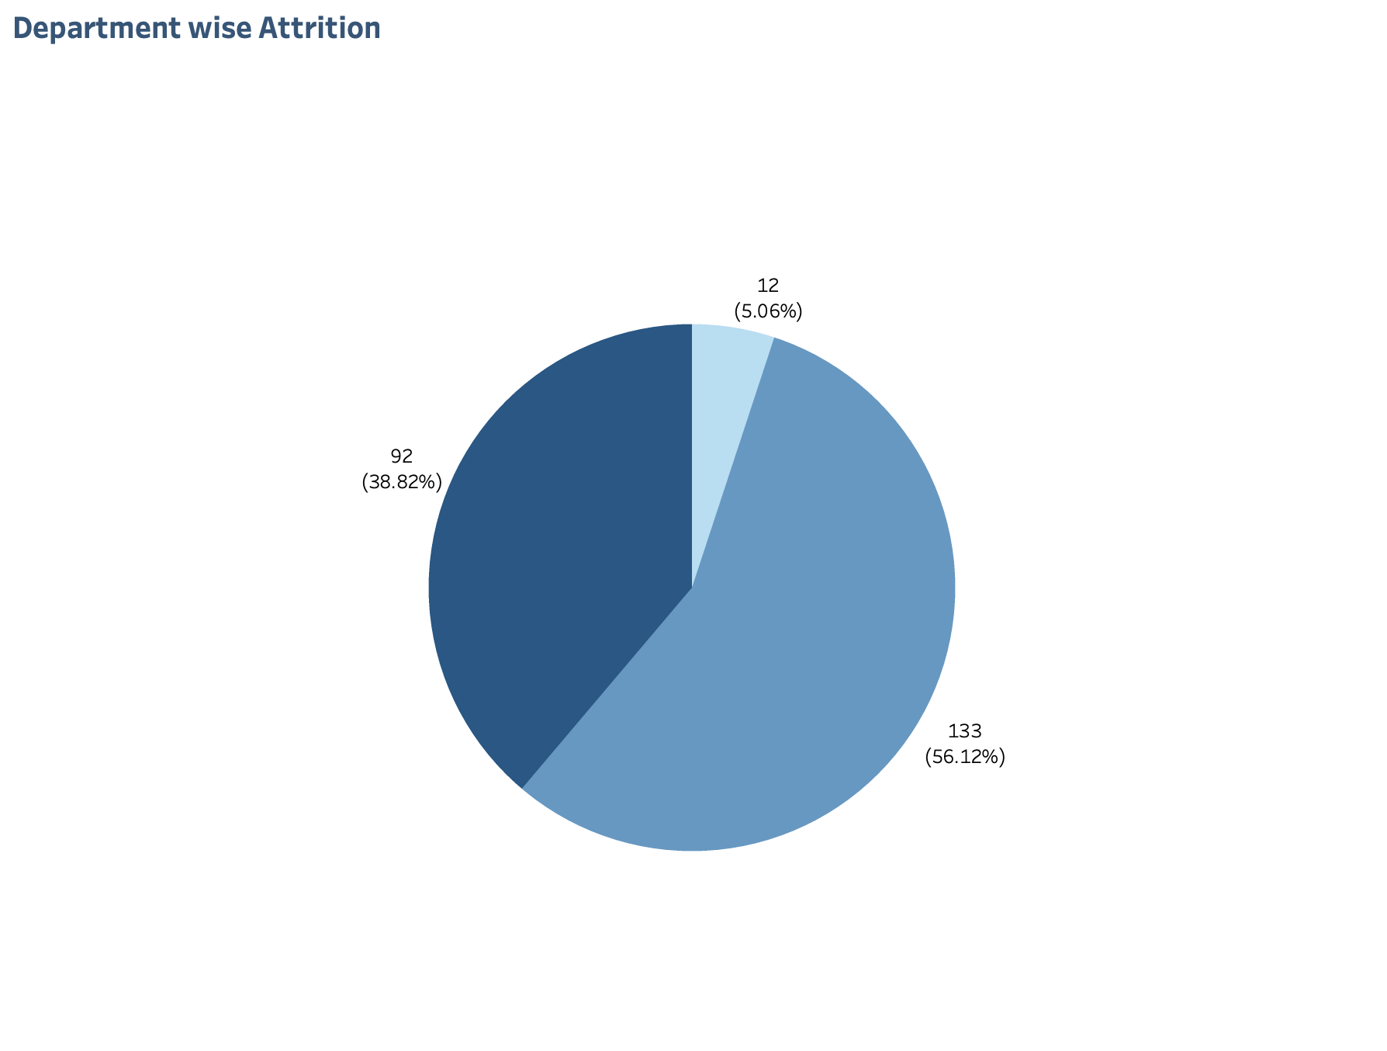
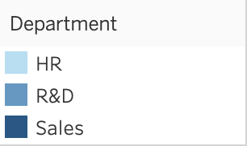
Focuses on key areas for improvement.

Slide 7
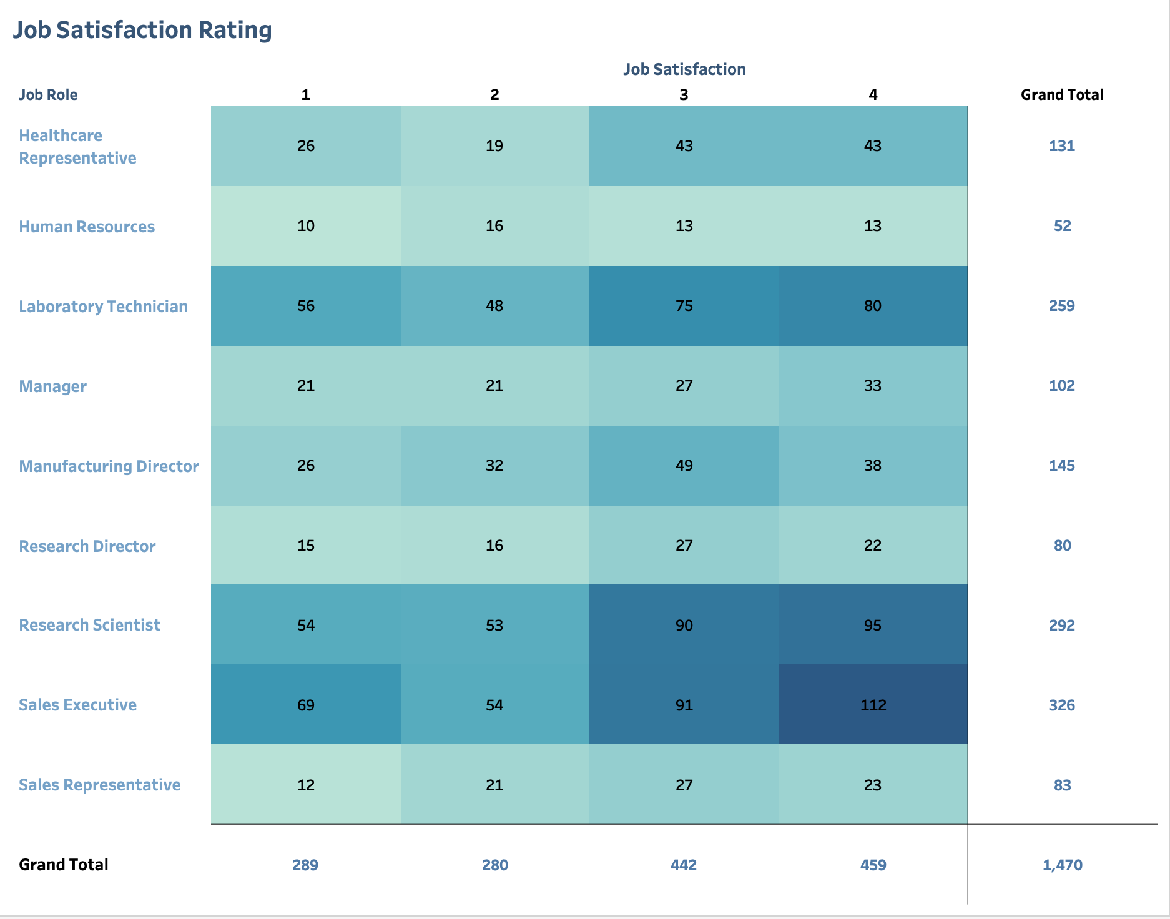
Directly ties employee satisfaction to potential turnover.

Slide 8
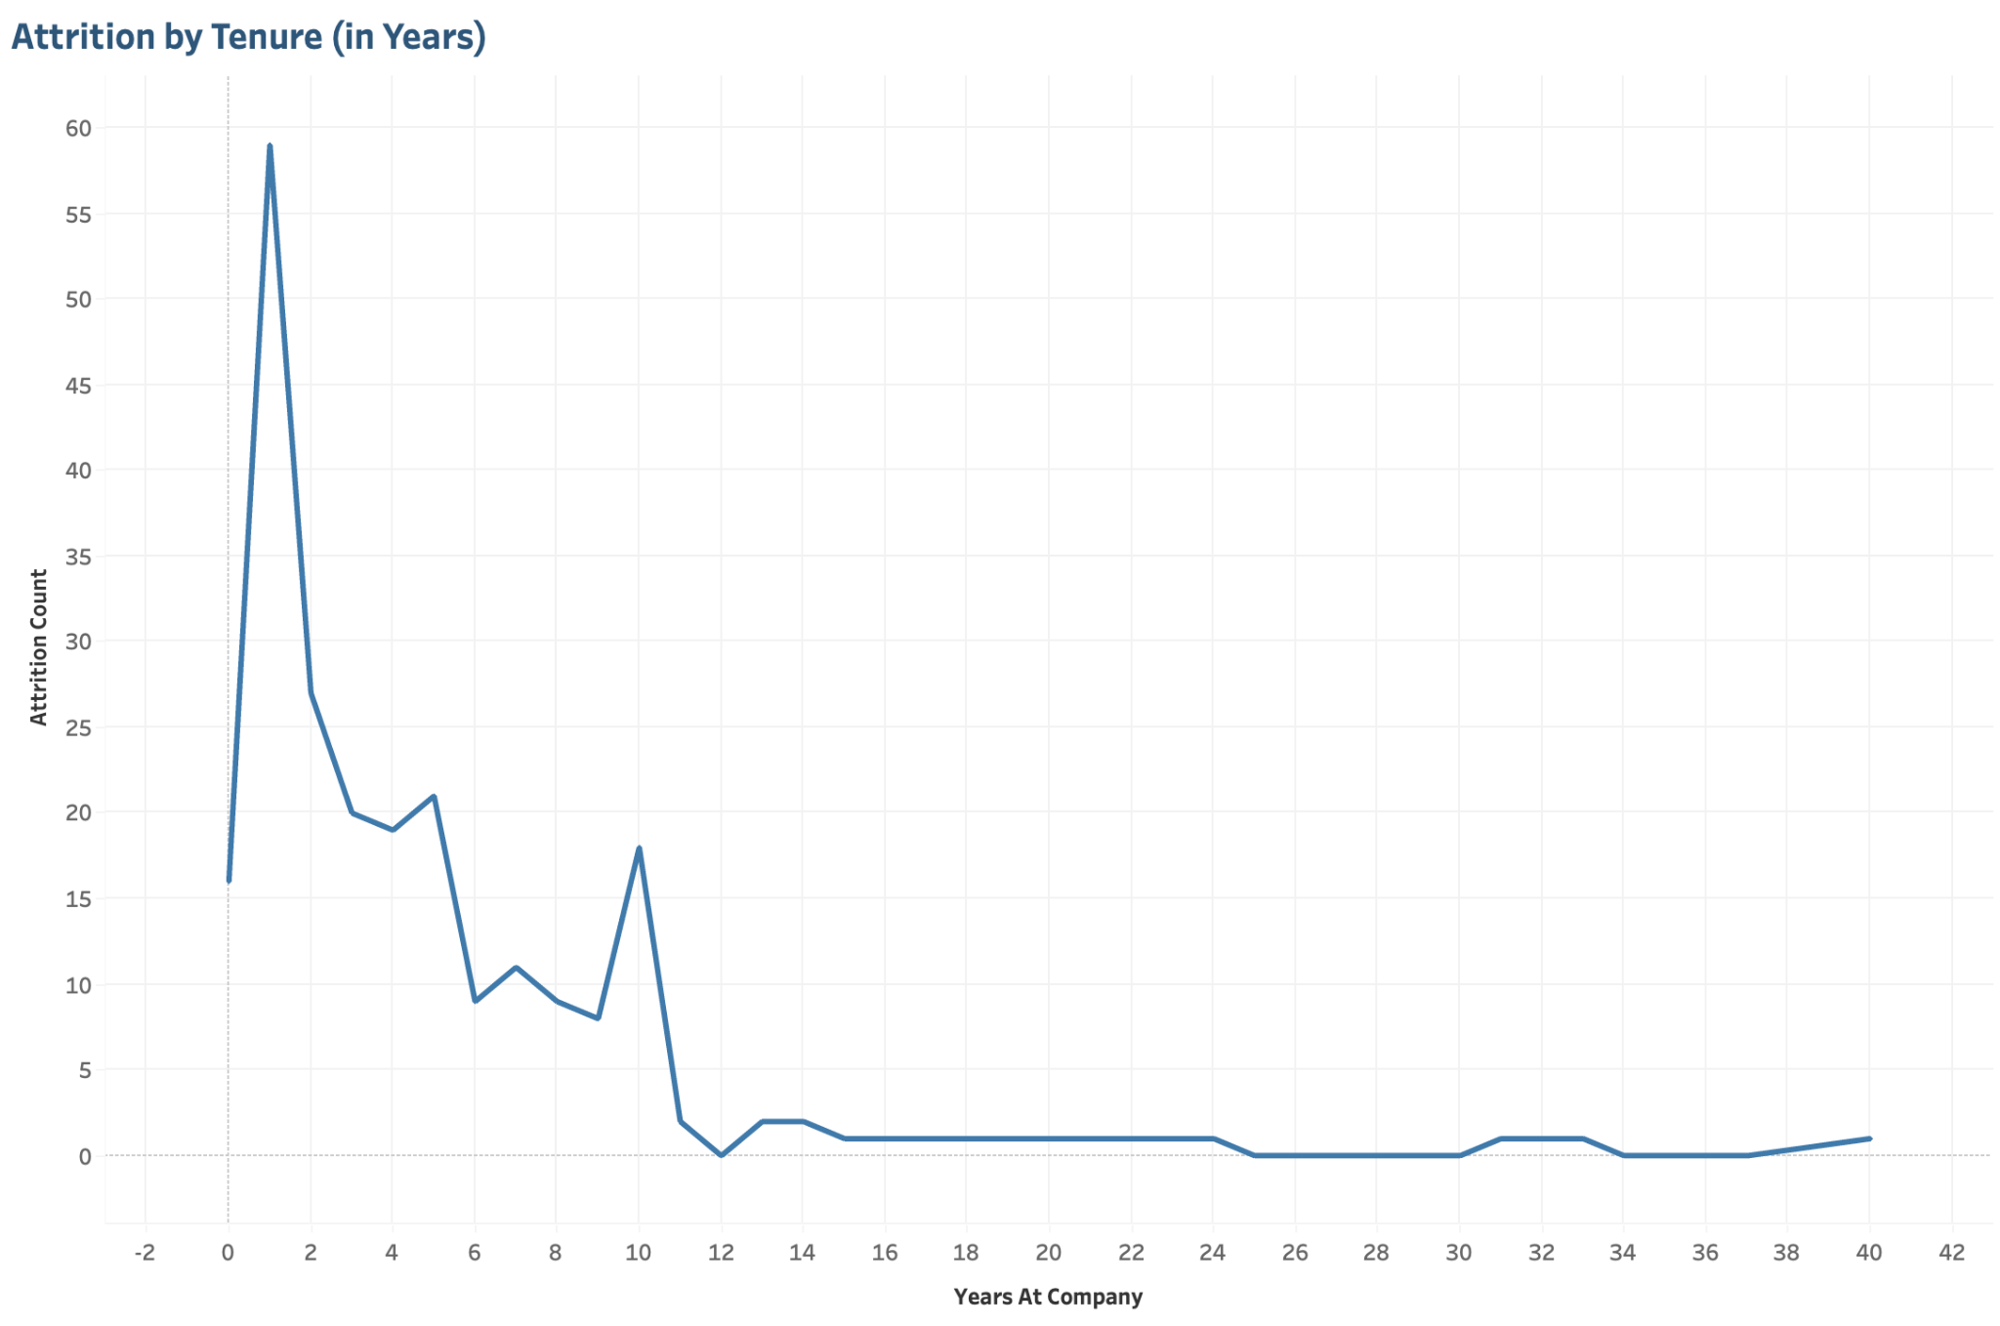
Early attrition is a critical area for intervention.

Slide 9
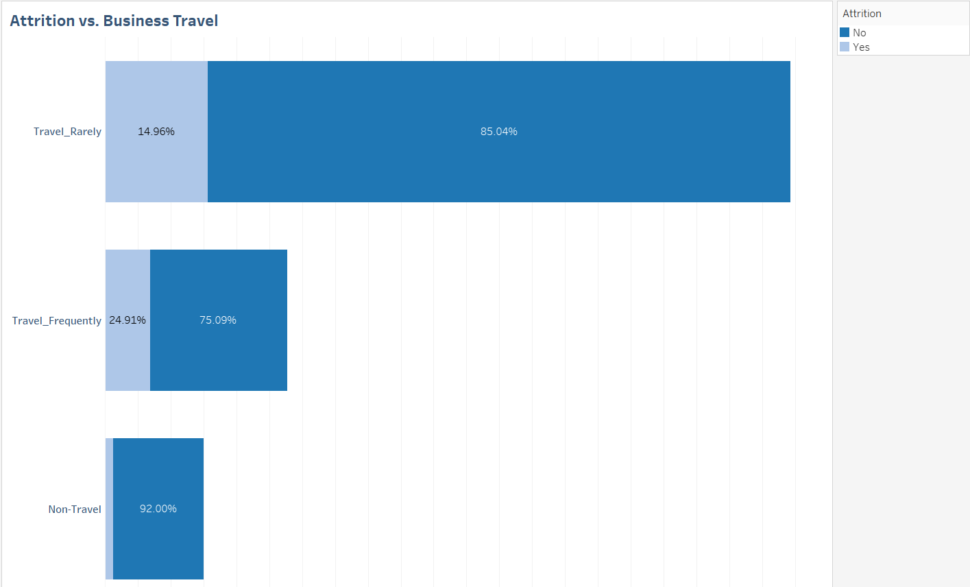
Provides actionable insights for optimizing travel policies.

Slide 10
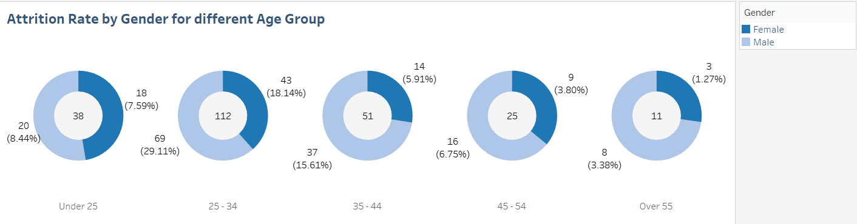
Adds demographic insights but may not lead to immediate action.

Slide 11
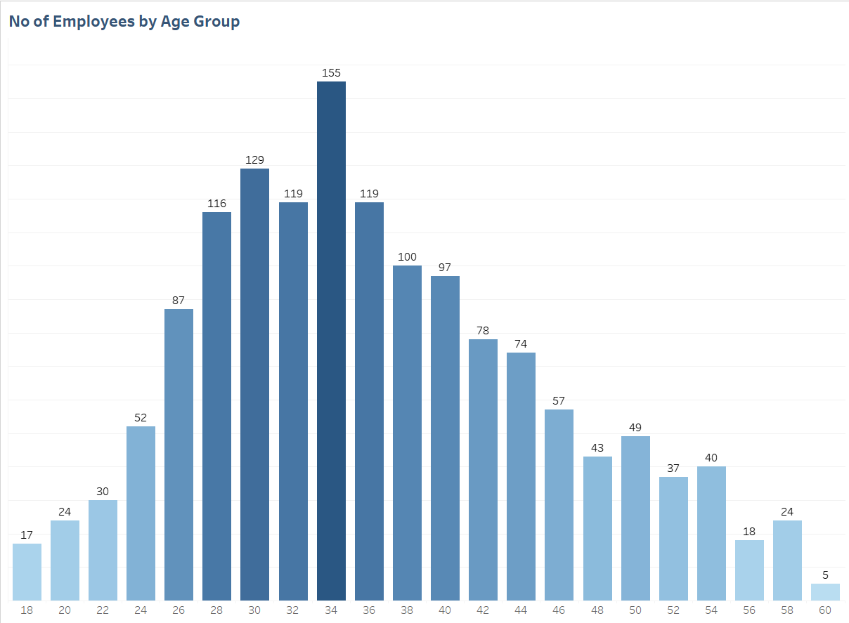
Broadly helpful but could be enhanced by including reasons for attrition.

Slide 12

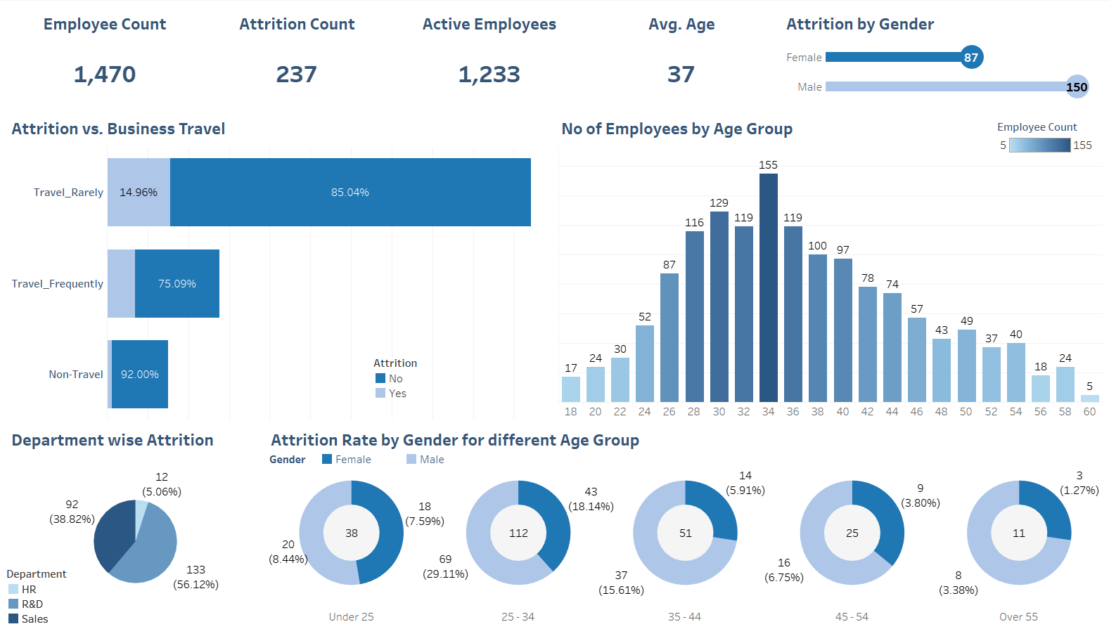

Dashboards

Slide 13
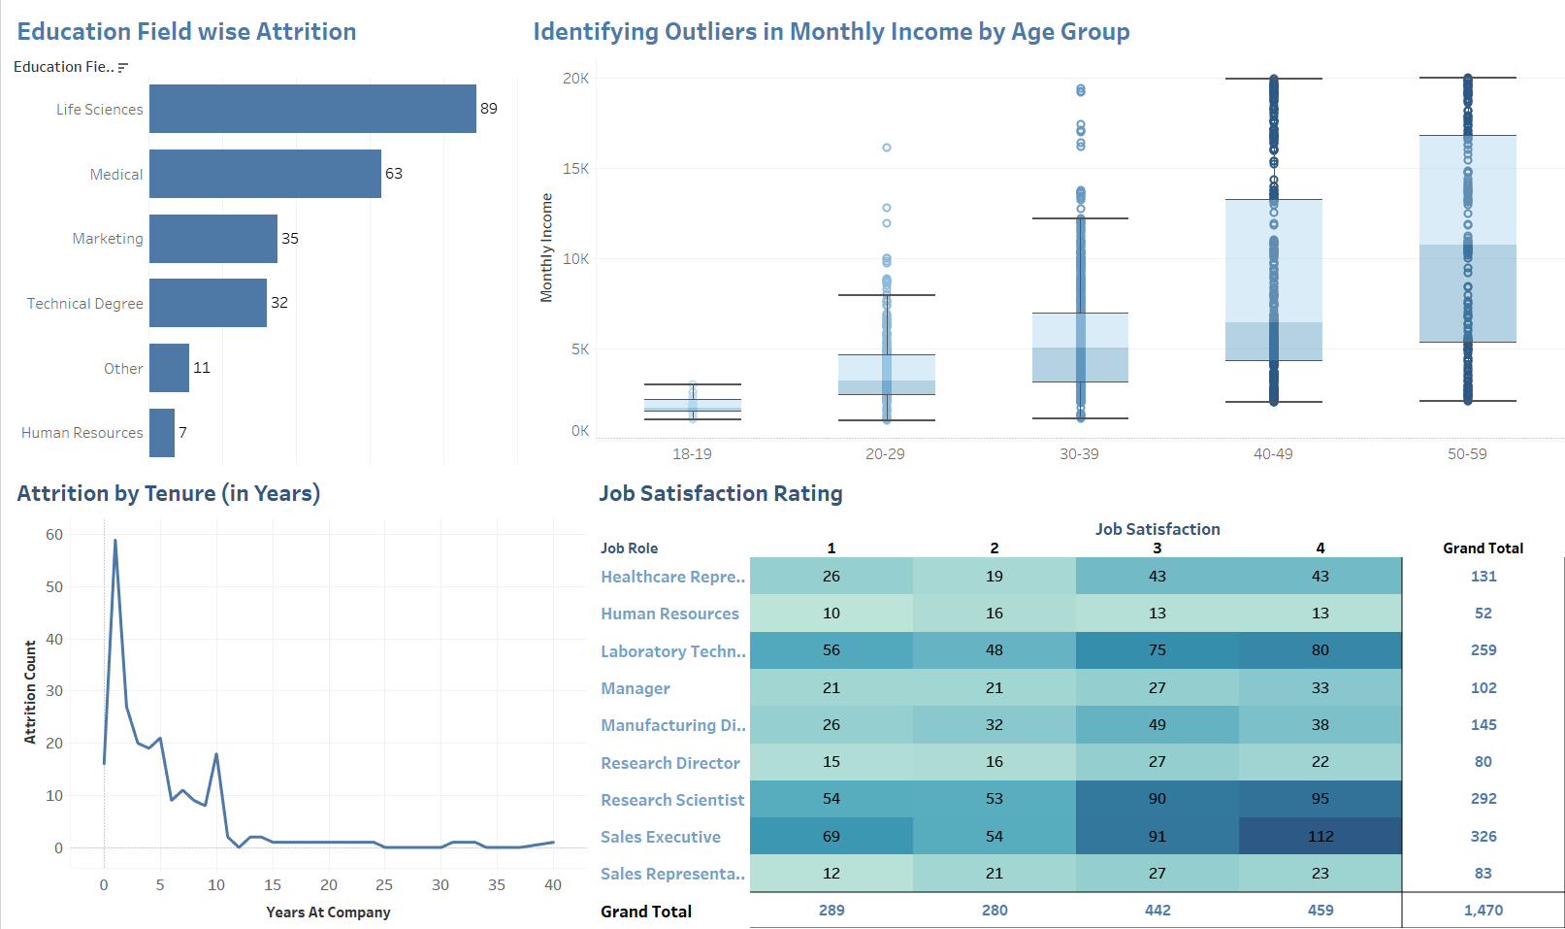

Slide 14

Data Visualization Evaluation: Opportunities for Improvement
Purpose
To analyze the effectiveness of visualizations in addressing project goals.
Data Accuracy
Ensuring reliable insights based on complete and consistent data.
Usability
The ease of navigation and clarity for stakeholders.
Impactfulness
The ability of the system to deliver actionable insights.

Slide 15
Identified Limitations
Data Gaps
Inconsistencies in certain data columns, such as "Preferred Working Platform" and "Work Mode."
Attrition data may lack deeper context, such as reasons for attrition.
Visualization Constraints
Overcrowded Charts: For instance, role comparisons in bar charts can appear dense and reduce interpretability.
Static Insights: Current visualizations do not adapt dynamically to new or updated data.
Interactivity Challenges
Filters for roles, platforms, and modes may overwhelm non-technical users.
Limited ability for users to drill down into specifics, such as individual departments or custom groupings.

Slide 16
Future Opportunities and Enhancements
Data Enrichment
Incorporate external datasets like industry trends or regional demographics to provide deeper insights.
Advanced Features
Implement predictive analytics to forecast attrition or productivity patterns and enhance decision-making.
User Experience Improvements
Streamline dashboard filters and layouts for better navigation and a more interactive experience.

Slide 17

Conclusion
This project highlights key drivers of employee attrition, including education, tenure, satisfaction, and travel. By identifying patterns and departmental challenges, we provide actionable insights to improve retention strategies. These findings empower HR teams to enhance engagement and build a more resilient workforce.

Slide 18


Thank you

